Slide 1
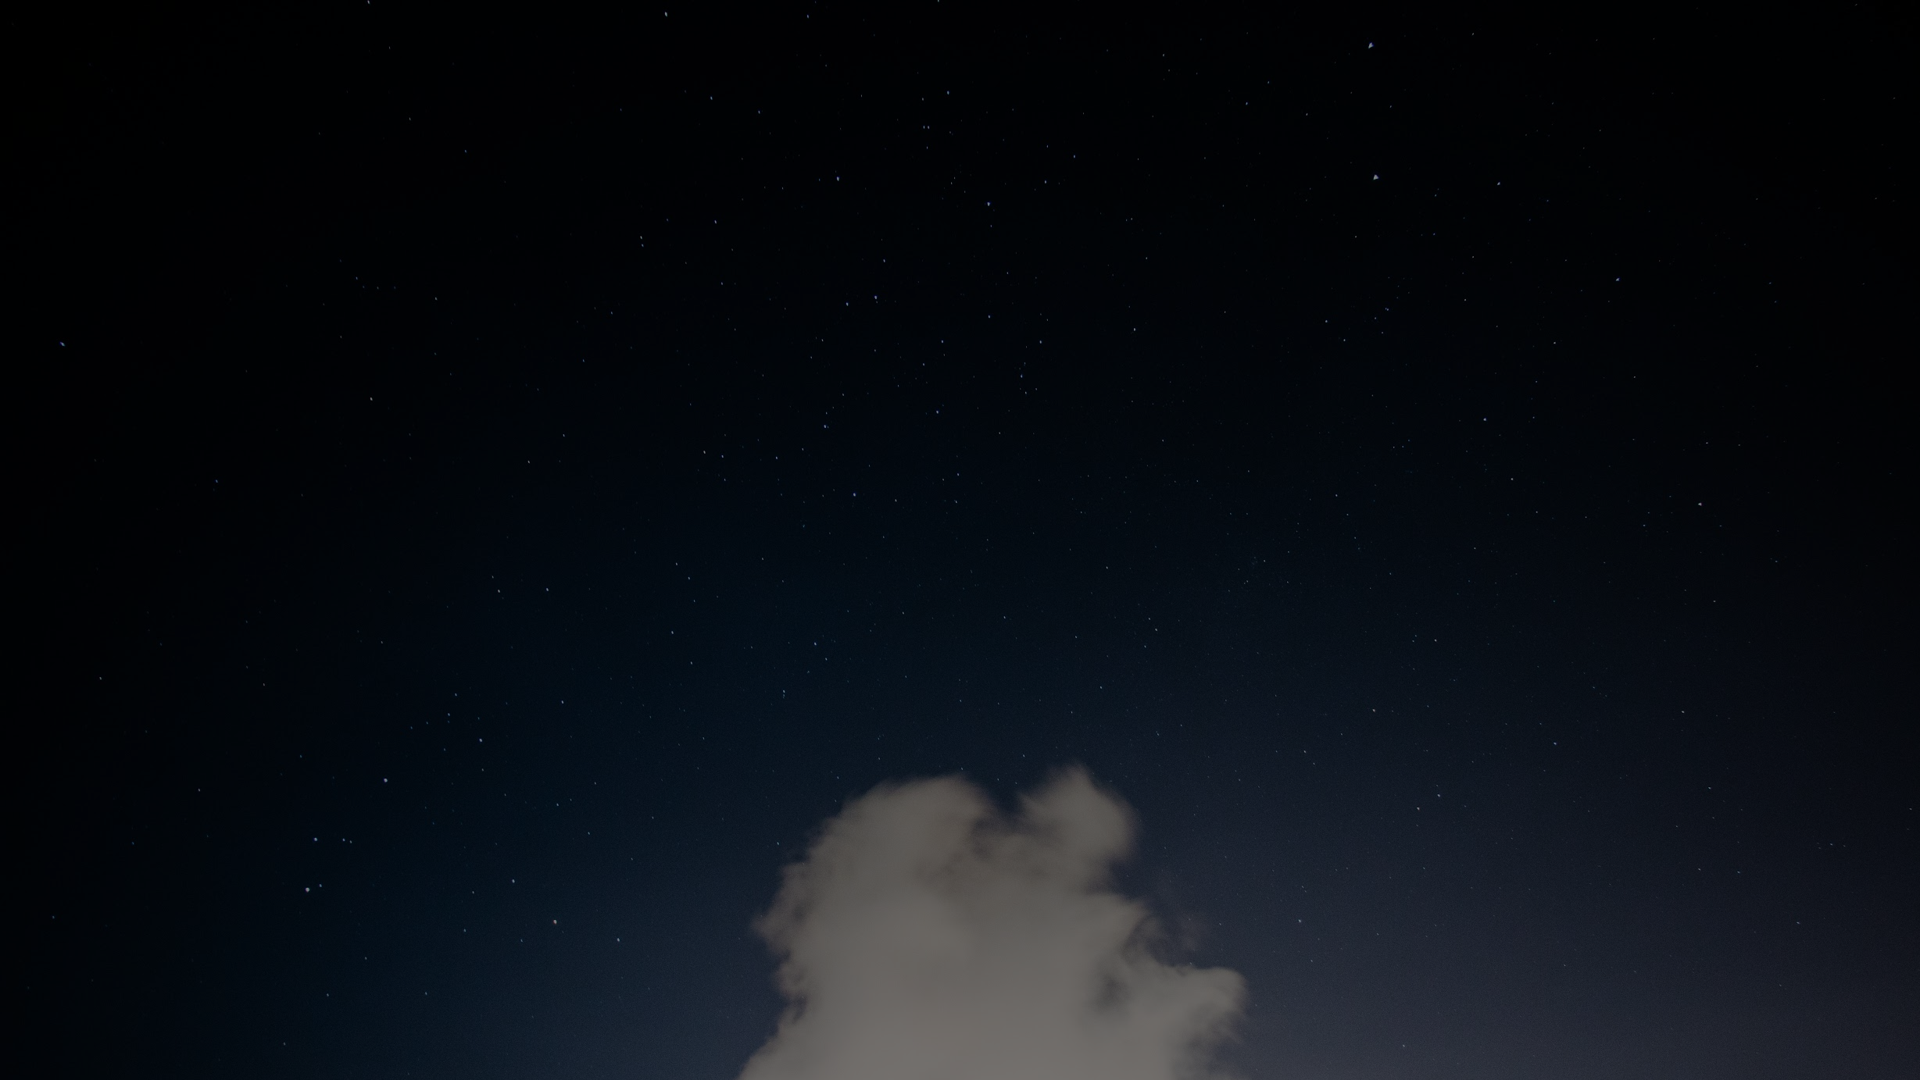
IITISoc’21 Face Mask Detection
Group Code: ML4
Akshat Nahata [200004002]
Mihir Karandikar [ 200001044 ]
Ayush Sinha [200001012]
Nilay Ganvit [200001053]
https://github.com/MihirK1212/ML4_Face-Mask-Detection

Slide 2
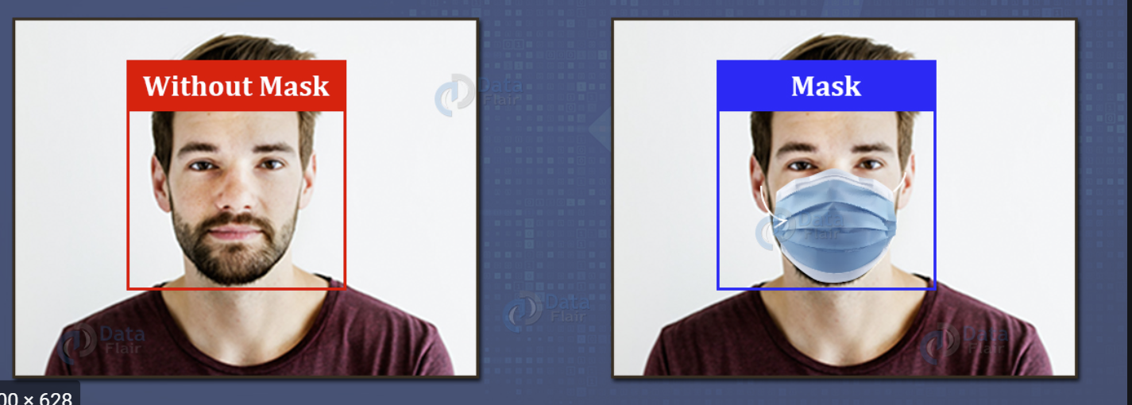
What is Face Mask Detection?
Face mask detection refers to detect whether a person is wearing a mask or not. In fact, the problem is reverse engineering of face detection where the face is detected using different machine learning algorithms for the purpose of security, authentication and surveillance.

Slide 3
Covid-19 Face Mask detection comprises of two phases:
01
The first phase: It involves training of the face mask detector.
The first phase can be further divided into two phases:
Training: Here we’ll focus on loading our face mask detection dataset from disk, training a model (using Keras/TensorFlow) on this dataset, and then serializing the face mask detector to disk
Deployment: Once the face mask detector is trained, we can then move on to loading the mask detector, performing face detection, and then classifying each face as with_mask or without_mask

Slide 4
Covid-19 Face Mask detection comprises of two phases:
02
The second phase comprises of applying face mask detector. First we have t load face mask detector. Then detect faces in a image. Extract each face roi. Apply face mask detector for each face ROI to determine mask or no_mask. Finally we have to output the results.

Slide 5
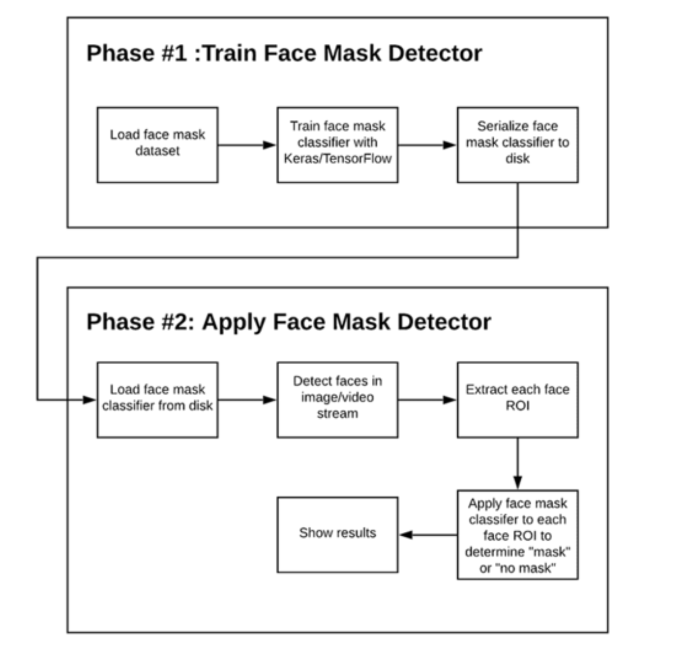

Slide 6
Importance Of Face Mask Detection The basic aim of this project is to identify whether a person is wearing a mask or not. Normally a human would be required to check , say on an airport, whether a person is wearing a mask or not. In this case the risk of spreading of virus is high as the inspecting human himself have to deal with thousands of people every day. This will increase the probability of him getting affected. To stop this we can use the idea of face mask detection which will not require any inspecting human and hence will reduce the risk of spreading of virus. This can also be used in security cameras at public places where people not wearing the mask can be identified and not be allowed to enter the park without a mask. We can synchronize the output with a door which only opens if a person is wearing a mask. Apart from this if this is modified further then this can be used to unlock, say , a iphone at public places where it can identify its owner who is wearing a mask. This will allow him not to touch the screen of his phone at such place.

Slide 7
Annotations
In image data set
Provide the particular information that the program needs of train.

Slide 8
Software used
Tzutalin
Name
LabelImg
Version
Windows 1.8.0
Site
https://tzutalin.github.io/labelImg/
GIT
https://github.com/tzutalin/labelImg
Maintained by

Slide 9
What are Annotations on Image DataSet
Annotation on an Image Dataset is an piece of information about the Image that helps the program to train itself. In this case it is in form of a .txt file with filename as same as the image containing the information about the number, type of object and their coordinates in a particular image.
This is stored in format in which the first numerical denotes the type of object in range of whole numbers which have been stored in the classes.txt file.
The second and third numeric entry stores the center of the x coordinate and the y coordinate of the object.
The fourth and the fifth numeric entry stores the width of the object and the height of the object.
Each of the above are stored in a single line while there can be multiple lines of these if there are more than one objects in a single image.

Slide 10
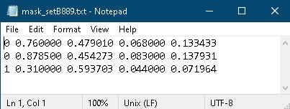

Slide 11
Steps to do annotations for a particular image.
01
Download the piece of software/program in the form of a compressed file from the site by following the like and choosing the appropriate version according to requirements, compatibility and system.
02
Extract the files from the compressed folder to a folder preferably in the root of the folder which contains the folder having the DataSet Images.
03
Place or transfer all the Images that have to be used for training in the folder mentioned in the previous step. Images can be gathered by using the download all/Zip all extension from the chrome web store and searching on Google Images.

Slide 12
Steps to do annotations for a particular image.
04
Ensure that the class of the objects we want to detect are saved properly in the Classes.txt file. If not edit it to the required program as 0 for Without_mask and 1 for With_mask
05
Open the program downloaded before, It should start in a window with panes on left and right with no image at the start as shown in the upcoming slide.
06
Ensure that the target directory is set to the folder of Image Dataset for both source and preparation of Annotations. If not change the settings and options to do so.

Slide 13
Steps to do annotations for a particular image.
07
Open the first Image by selecting it from the right bottom pane which displayed all the Images in the folder. And select the next one to edit repeating until all the images are properly annotated.
08
To start drawing a rectangle around the object click the button for same from the left pane or perform the keyboard shortcut for it. Once the cursor has changed to the drawing tool, make the rectangle on the appropriate coordinates by dragging the cursor diagonally over the region and lifting once adjusted.
09
Greeted by the sub window select the class of object and hit enter to go for annotating another object in the same picture or got the next picture by clicking next on the right pane or choosing the desired image from the left pane list.

Slide 14
Finishing
Select all the Images and the annotations file created in the folder along with the classes.txt file and compress them into a single Zip and naming it according the title used in the code preferably taining_images. And then upload this archive to the location in the drive which has to be ported into your google collab or jupyter notebook project.

Slide 15
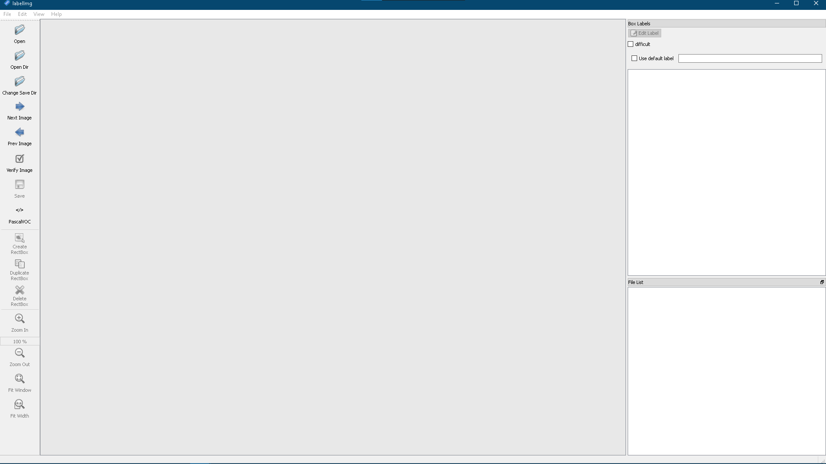
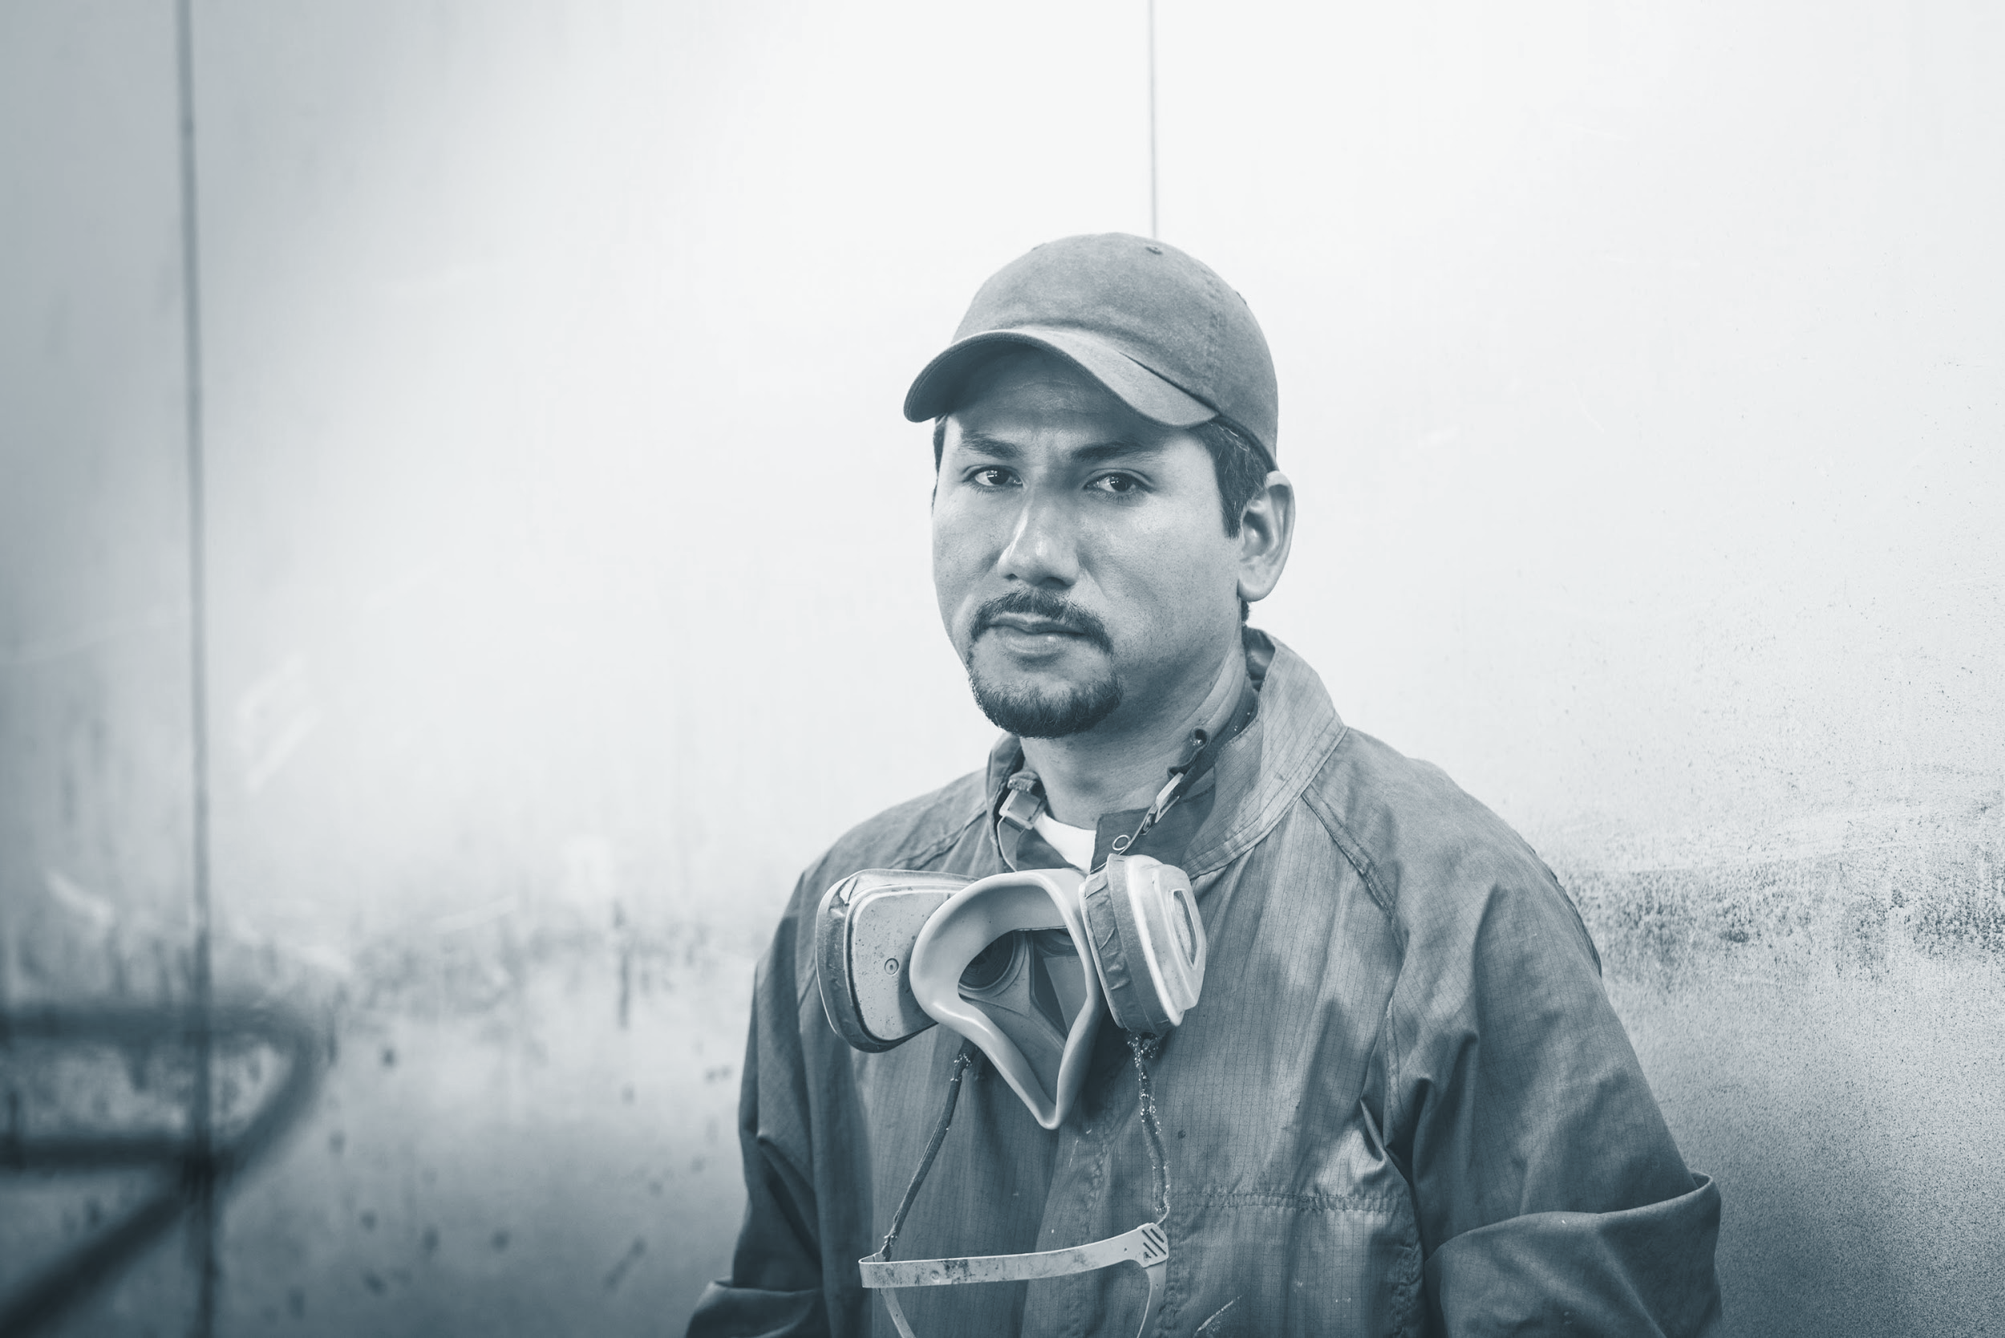
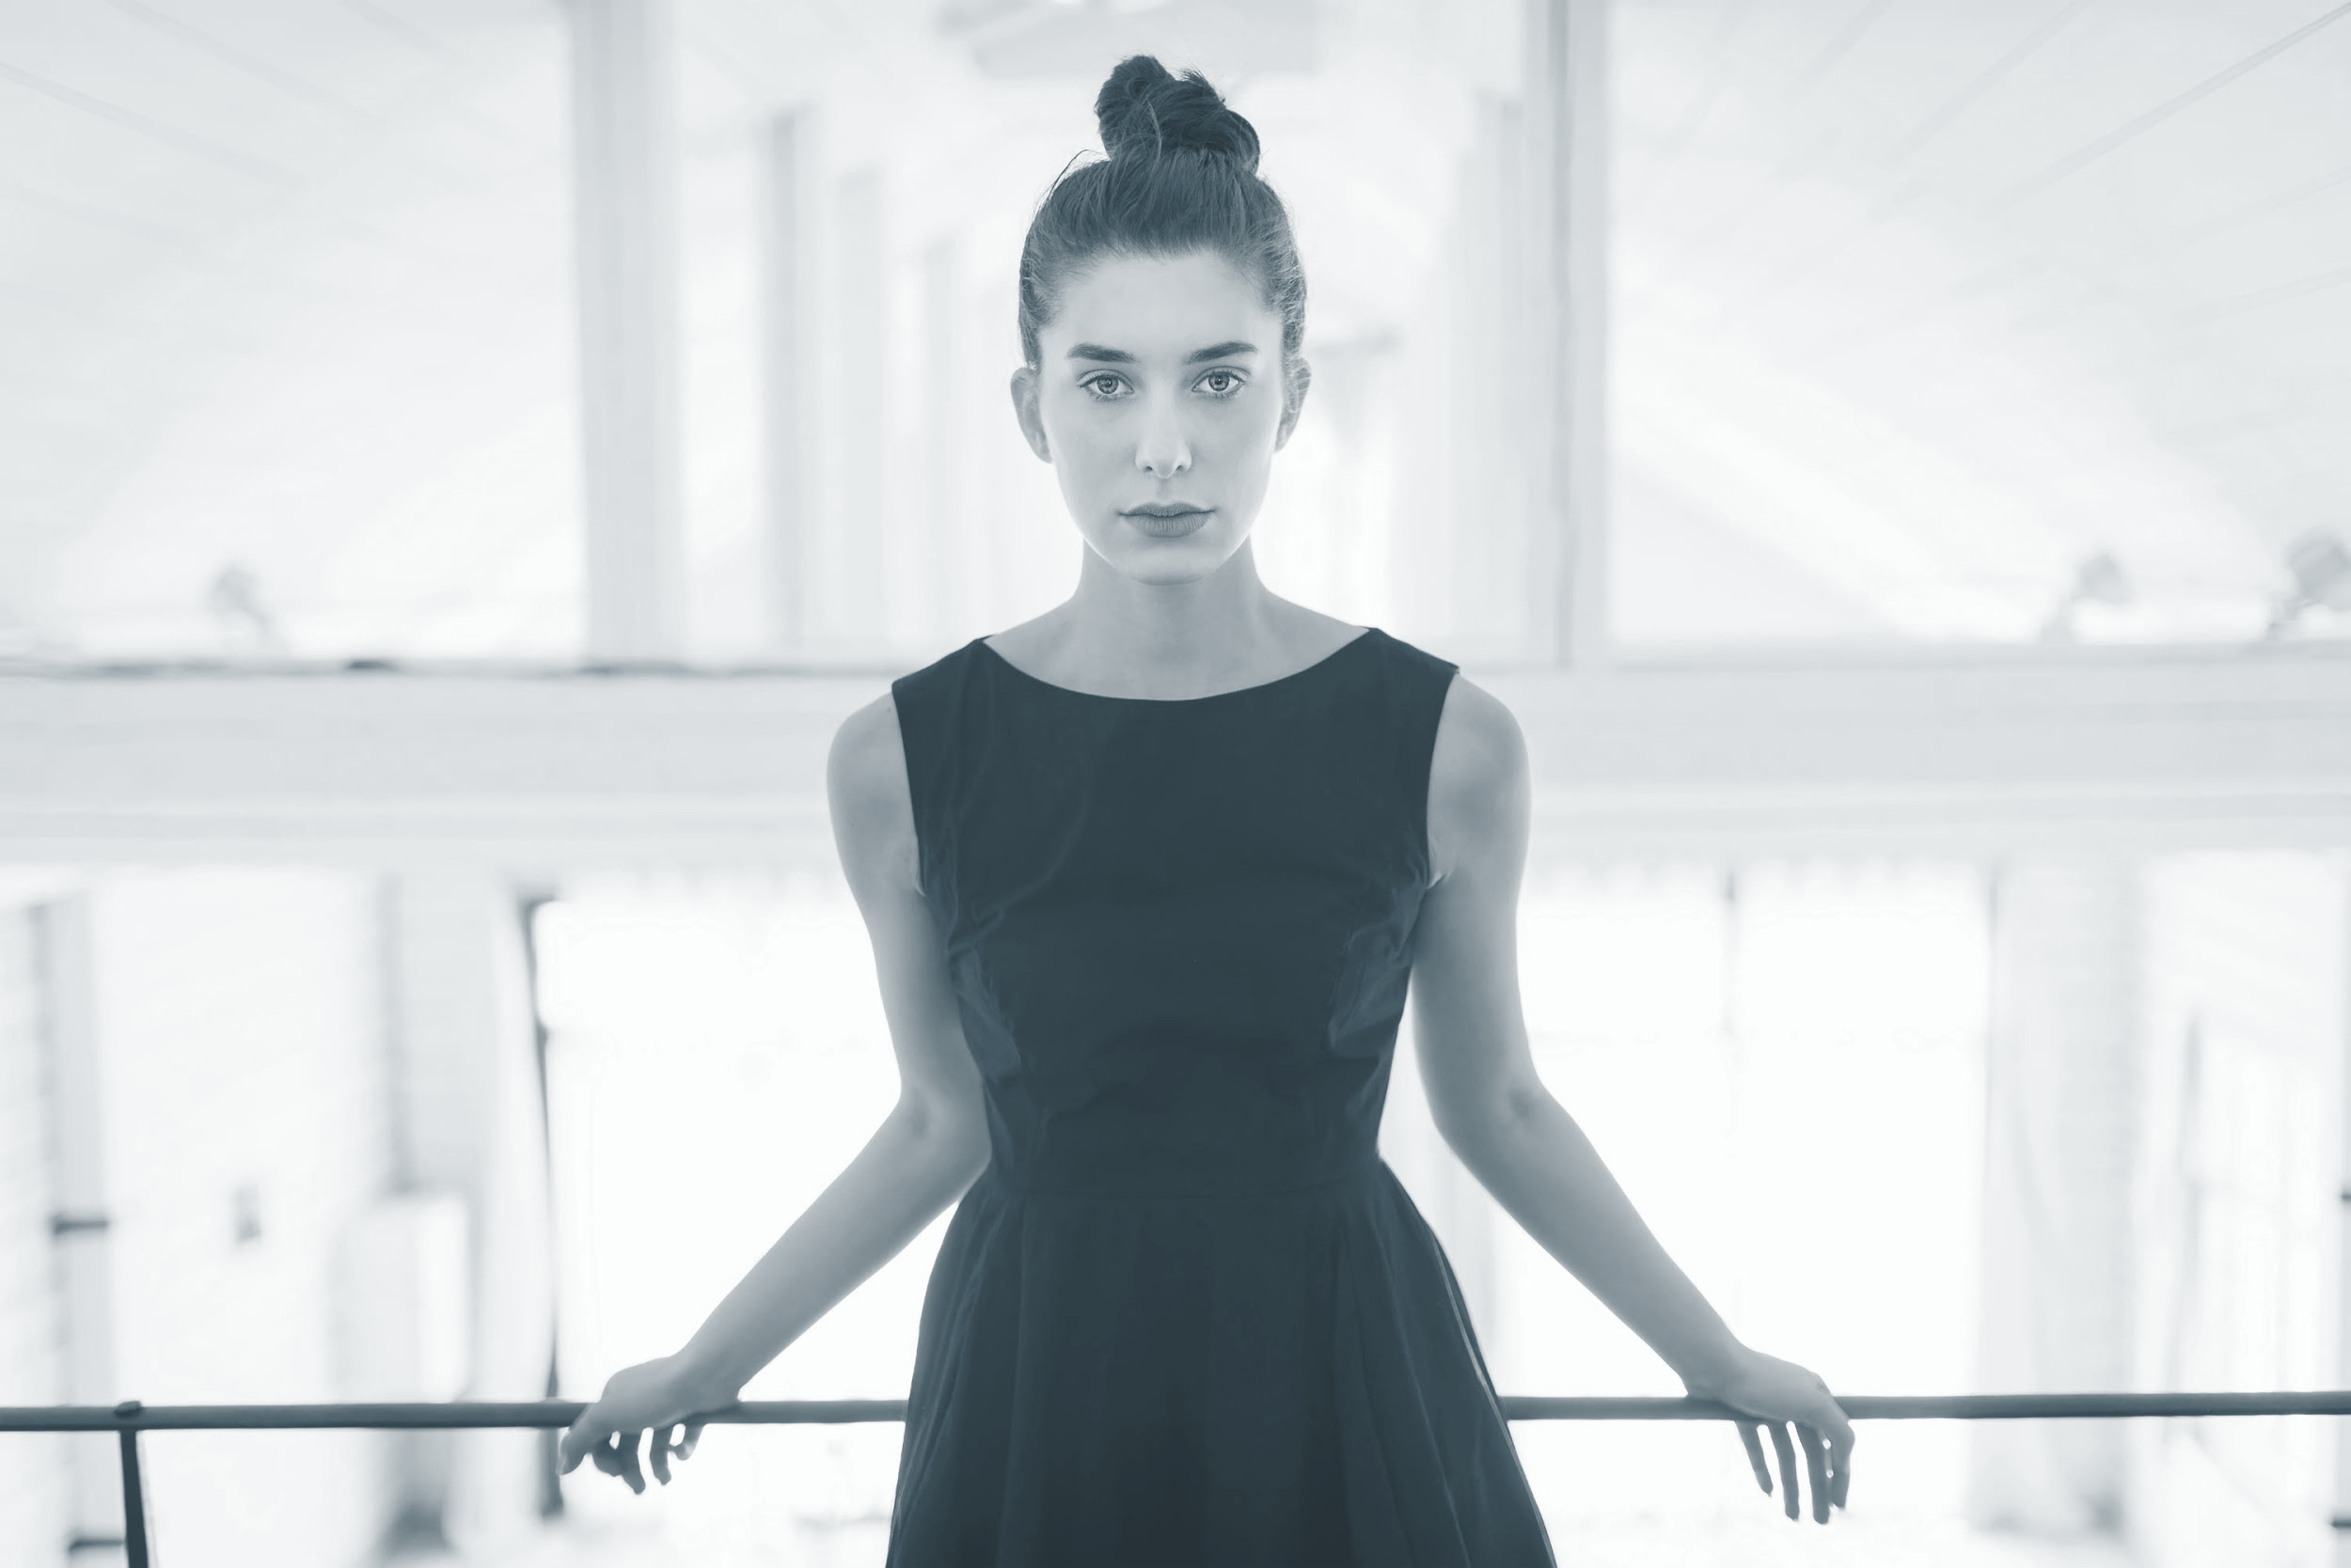
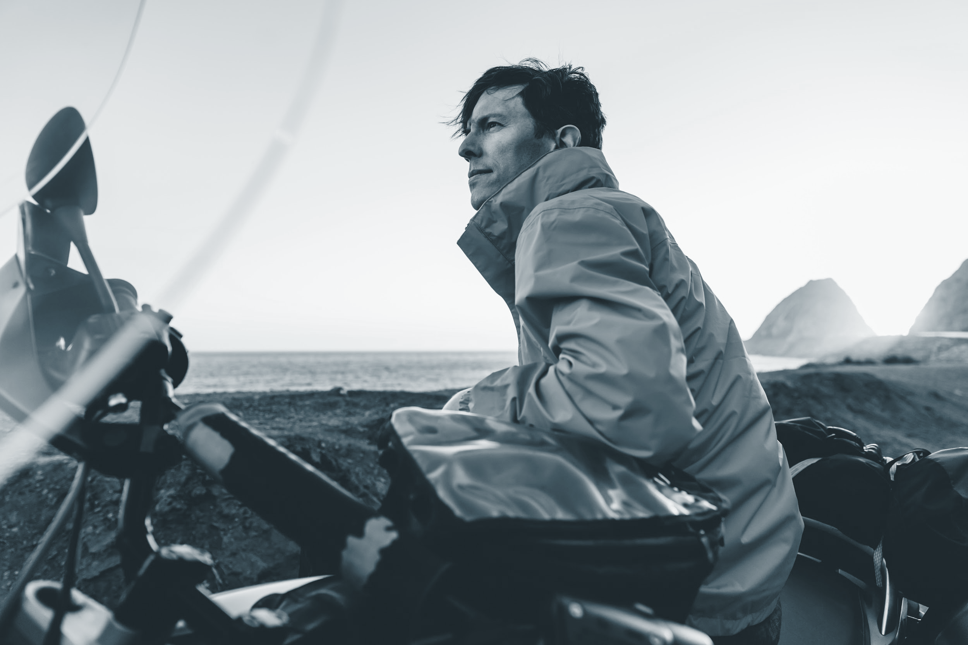
Program/Software

Slide 16
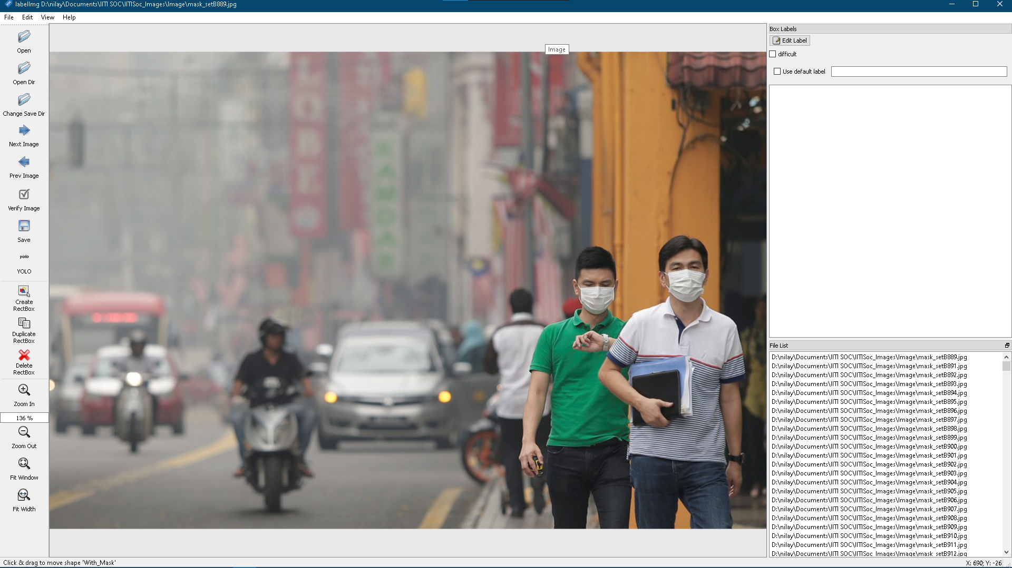
Configuration

Slide 17

Process (Ctrl+Click to view)

Slide 18
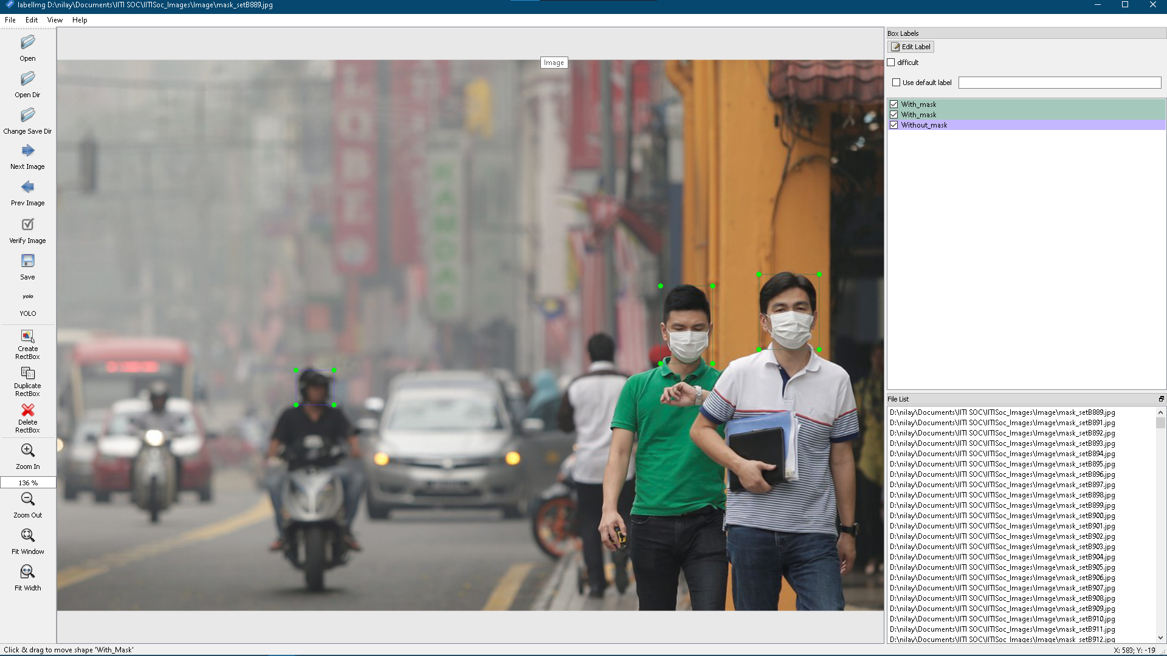
Final Image

Slide 19
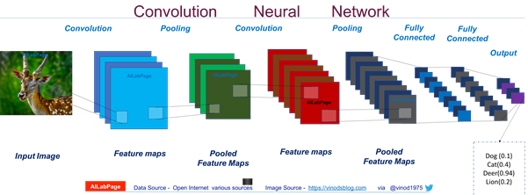
Convolutional Neural Networks
A Convolutional Neural Network is a specialized type of neural network generally used for image detection and classification purposes. One layer of a convolutional neural network typically comprises of the following components:
1)An input volume and an output volume where each volume unit is a number (a pixel value)
2)Filters or Kernels of specific dimensions
3)A number of parameters such as the number of filters to be used, the stride, the padding value etc.

Slide 20
Models Experimented With
A Basic custom convolutional neural network with Convolutional , Max Pooling, Batch Normalization and Dense Layers. On experimenting with many such models (changing the batch size, learning rate, the layers) we found out that the training was getting saturated around 75% accuracy.
Then we tried to implement some form of transfer learning into our model to make if perform more efficiently.
Going ahead with this prospect, we came across two prominent models: the MobileNet V2 and the YOLOv3. Although the Mobile Net V2 did a fine job, bounding box prediction was not inherently a part of the model .YOLO v3 along with darknet 53 turned out to be the best bet as it was capable of both object detection as well as classification.
Another model that we did not try but looked at was the SSD (Single Shot Detector). One shortcoming for this model however was the slightly higher time it took to achieve a good precision value, and detecting masks in real time will require faster detections. In terms of precision, both YOLO and SSD perform more or less equally.

Slide 21
The YOLOv3 Face Mask Detector
Features:
YOLO stands for You Only Look Once
A single neural network is used for object localization and classification
First half= 53 layer CNN called darknet 53 which is used for feature extraction
Second half= another 53 layers used for bounding box predictions
These 106 layers are followed by batch normalization layer and leaky RELU activation function layer. For the purpose of object detection from the probabilities, softmax regression is used.
Residual blocks are also used within the first 53 layers. Residual blocks are those in which activation of one layer is transported or fast forwarded to a deeper layer in the neural network. (Code is present in the repository)

Slide 22
Details regarding the YOLOv3 Model
No explicit pooling layers (instead downsizing layers with stride=2 and values=1) (this prevents loss of features)
Bounding box bredictions occur at layers:
Layer 82 (stride=32, for large objects)
Layer 94 (stride=16, for medium sized objects)
Layer 106 (stride=8, for small objects)
The image in these layers is divided into grid cells and each grid cell has B*(5+C) values associated with it where
B= maximum number of bounding boxes per grid cell
5= for object confidence, x and y positions of center, height and width
C= probability values for the ‘C’ classes

Slide 23
Input
Output
Images with their .txt annotations
x,y predictions for the centre of an object with respect to the top left corner of a grid cell and the corresponding width and height of the bounding box

Slide 24
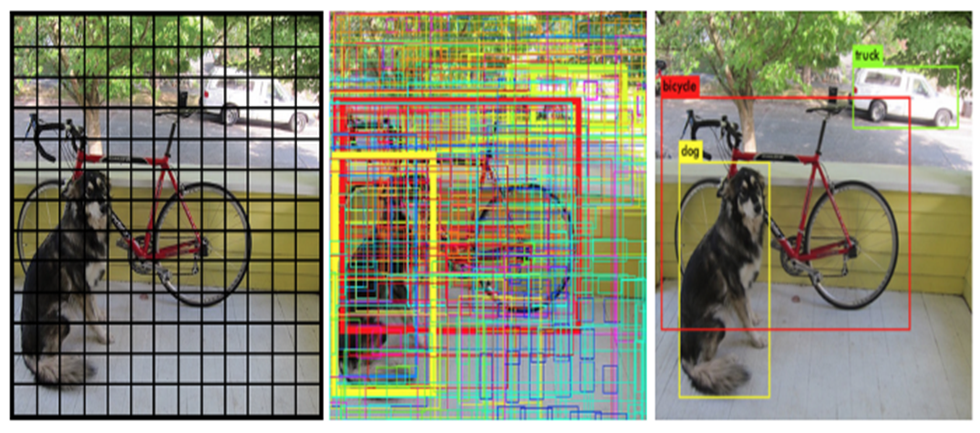
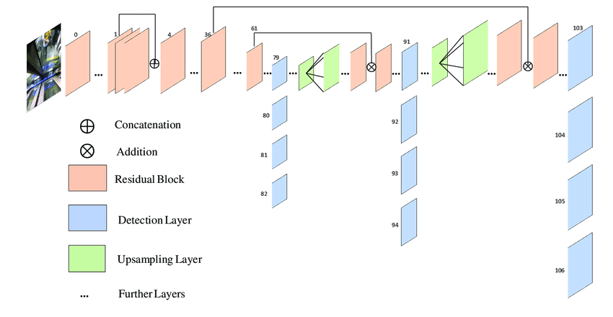

Slide 25
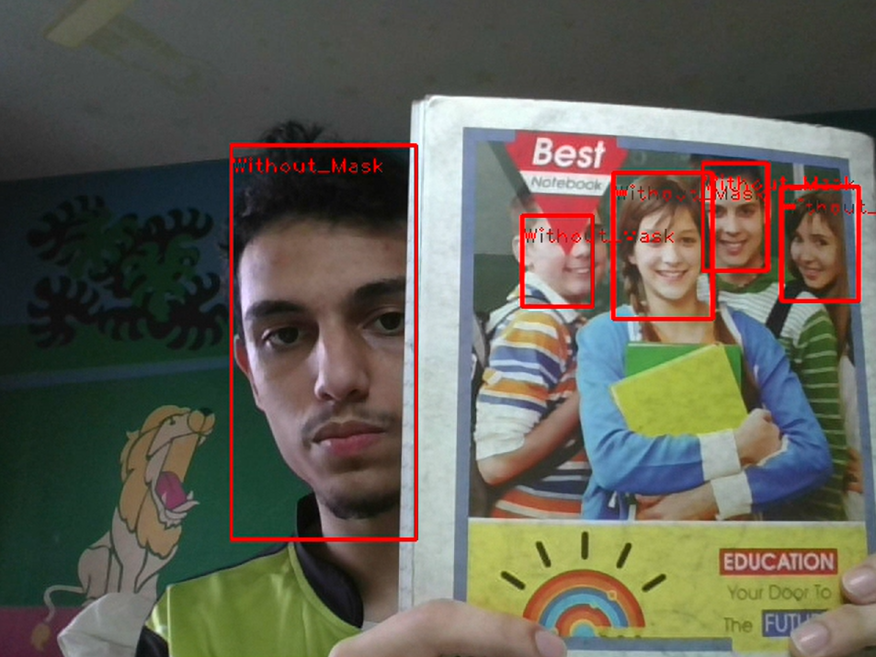
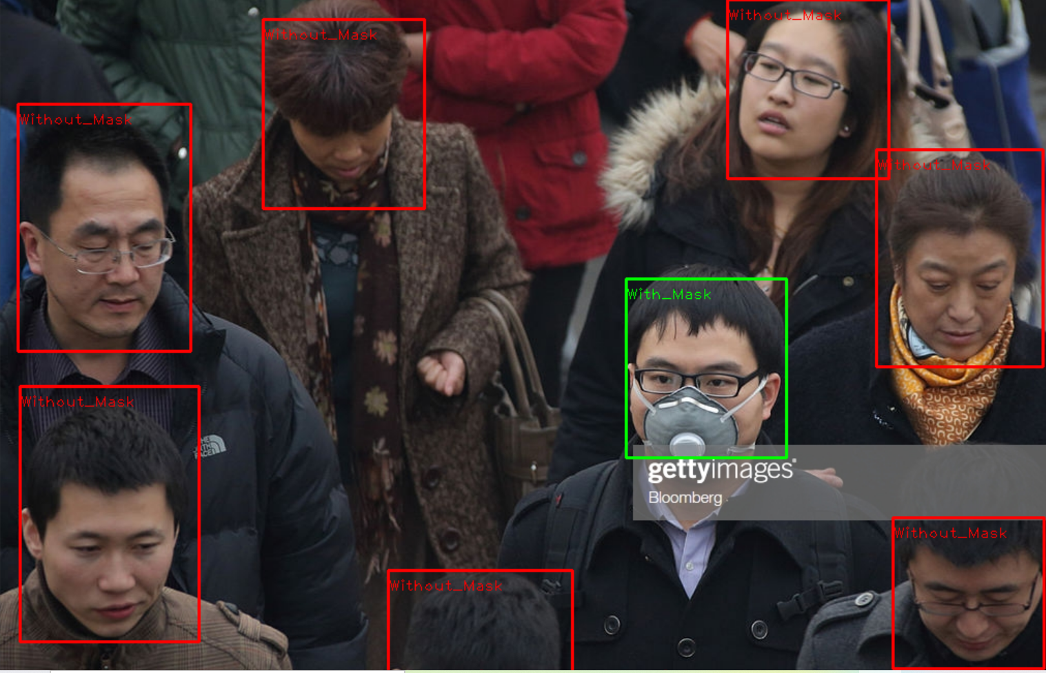
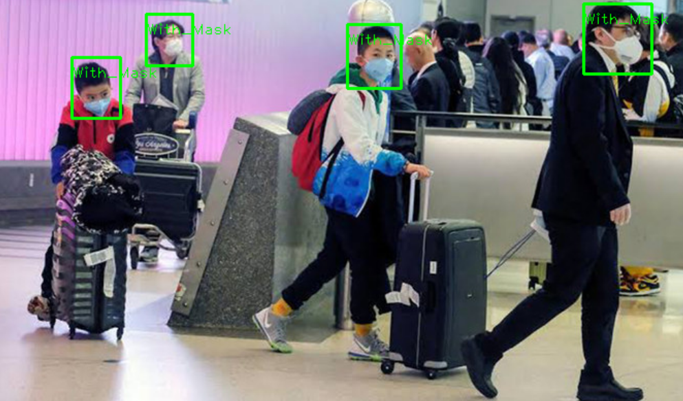
Results

Slide 26
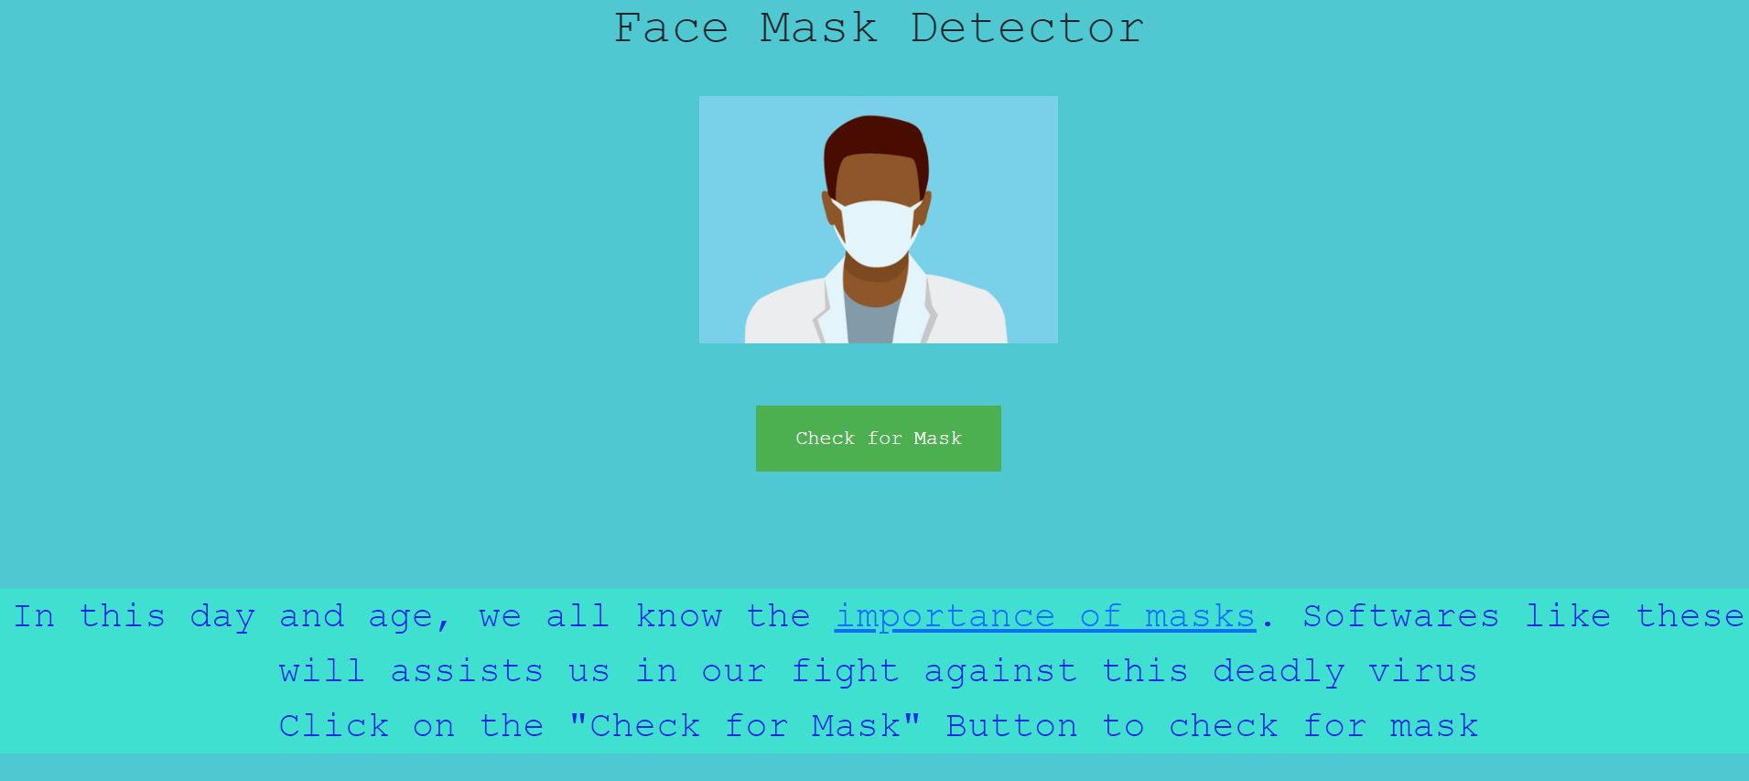
Interactive Portal

Slide 27
Model Metrics
Accuracy= (TP+TN)/Total
Precision= TP/(Predicted Positive)
Recall= TP/(Actual Positive)
For a Test set of 200 Images:
Total Detections: 294
For Positive=With_Mask and Negative=Without_Mask
TP=190 TN=86 FP=10 FN=8
Accuracy: 0.9388
Precision: 0.9500
Recall: 0.9560
F1-Score: 0.9530
Mean IoU: 79.44%
(Let’s say that the ground truth bounding box for some object is A_{g} and predicted bounding box is A_{p} then: IoU= (Intersection area b/w A_{g} and A_{p} )/ (Union area b/w A_{g} and A_{p} )

Slide 28
FLASK?
About Frontend
Why did we use

Slide 29
About Flask
Flask is a web framework. This means flask provides you with tools, libraries and technologies that allow you to build a web application

Slide 30
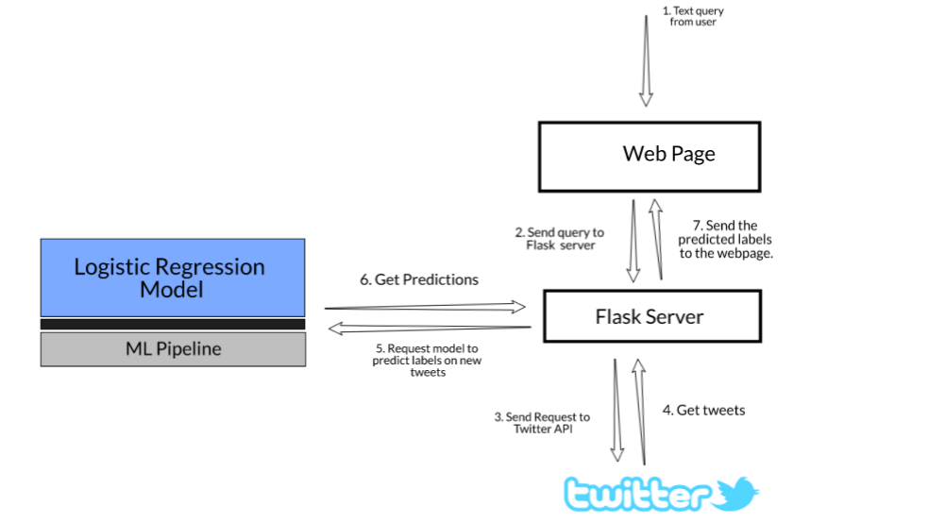
This is how flask, webpage and ML model communicates!!

Slide 31
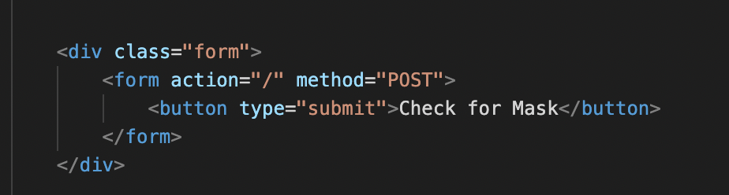

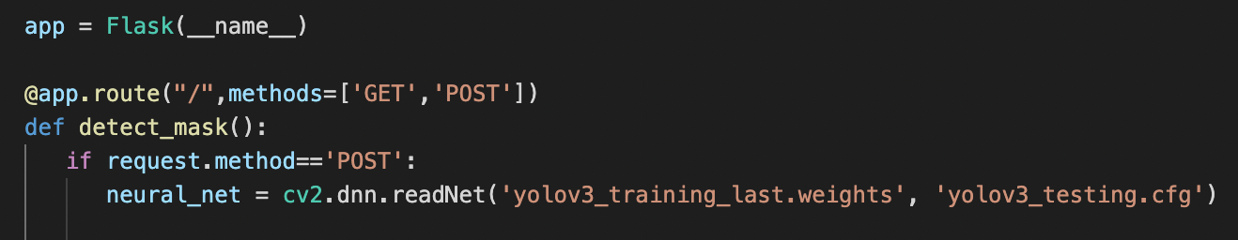
Redirecting from HTML to flask application

Slide 32
Challenges we faced!!
Less accuracy with certain models.
Hardware Limitations.
Kaggle was fast but we used Google colab as it has better integration with google drive.
Incompatibility of different versions of libraries and modules.
Dataset problems.
Time for annotation.
Connecting front end to ML model.
Communication problems while coding and training ML models.

Slide 33
Workflow Summary
Learnt about python libraries keras, opencv, scikit learn, etc.
Develop the code for training the ML model using resources provided by mentors.
Search Dataset, make annotations using labelimg(V.1.0.8)
Train the model.
Check the accuracy and rerun it on different configurations like learning rate, image type, image size.
Develop the front end using flask, HTML, CSS.

Slide 34
Thank You

